Slide 1
Team: Navy Seals Craiova, 2022
EXPLORING VENUS TOGETHER

Slide 2
What we are going to do:
Design a lander that can harness available resources situated near the surface of the planet to store enough energy in a battery that will last at least 60 days;
Design rovers that explore the surface of Venus using the electricity stored in the lander.

Slide 3
What problems we're facing:
Extreme high temperature

Slide 4
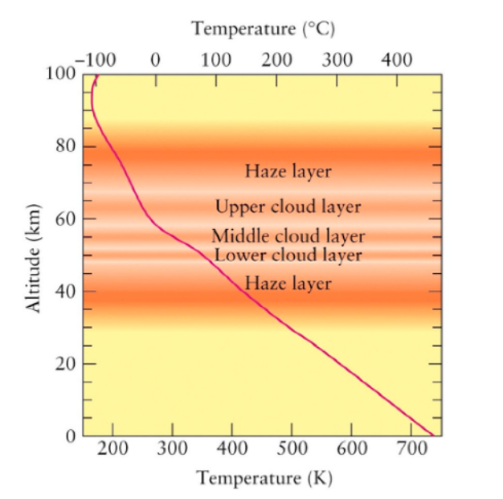
Temperatures on Venus
The CO2 rich atmosphere generates the strongest greenhouse effect in the Solar System.
Mean temperatures on the surface are about 464°C.

Slide 5
What problems we're facing:
Extreme high temperature
High atmospheric pressure

Slide 6
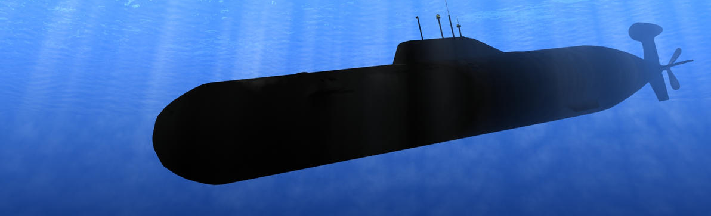
High atmospheric pressure on Venus
Atmosphere: CO₂ (96.5%), Nitrogen (3.5%)
Corrosive environment: concentrated H₂SO₄ and sulfur compounds
The atmospheric pressure on the surface of Venus is equal of a submarine submerged at around 1km in the Earth ocean
The surface pressure is 93 times higher than on Earth ( 93 bars )

Slide 7
What problems we're facing:
Extreme high temperature
High atmospheric pressure
Lack of direct sunlight due to clouds

Slide 8
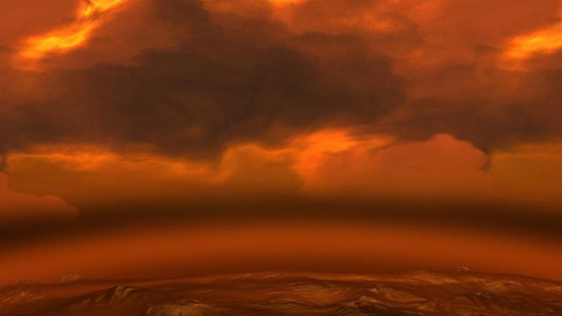
Thick Clouds
Venus is shrouded by an opaque layer of clouds that reflect and scatter about 90% of the sunlight into space.

Slide 9
What problems we're facing:
Extreme high temperature
High atmospheric pressure
Lack of direct sunlight due to clouds
Harsh rocky terrain

Slide 10
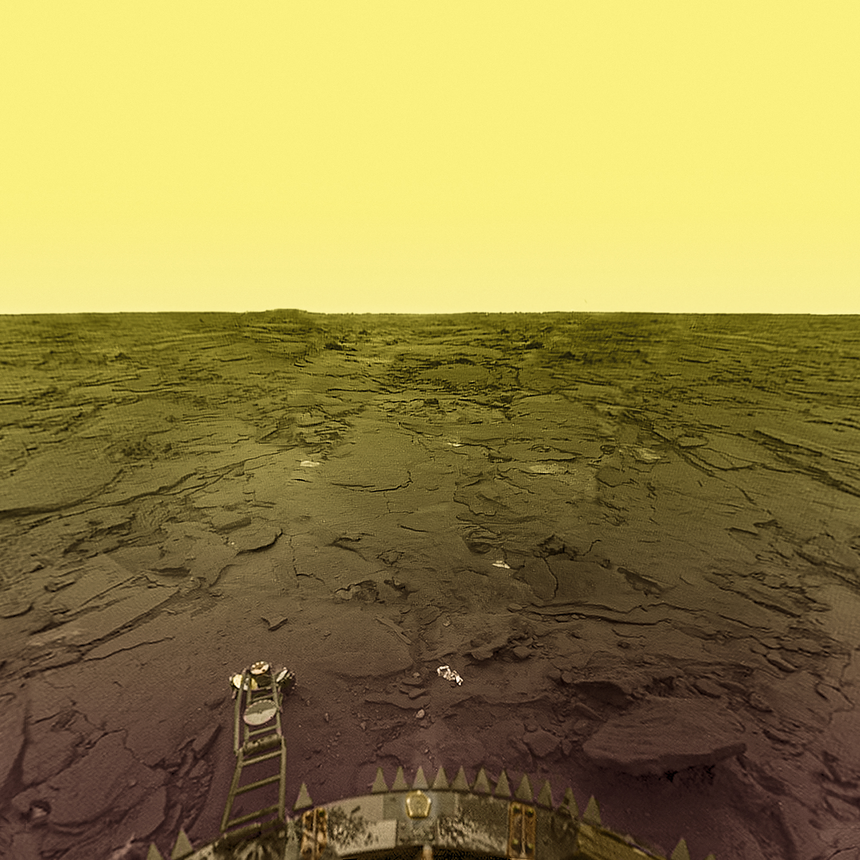
Rocky Terrain
The surface of Venus is made of rocks eroded by winds with some mountain peaks up to 10 km.

Slide 11
What problems we're facing:
Extreme high temperature
High atmospheric pressure
Lack of direct sunlight due to clouds
Harsh rocky terrain
Previous landers

Slide 12
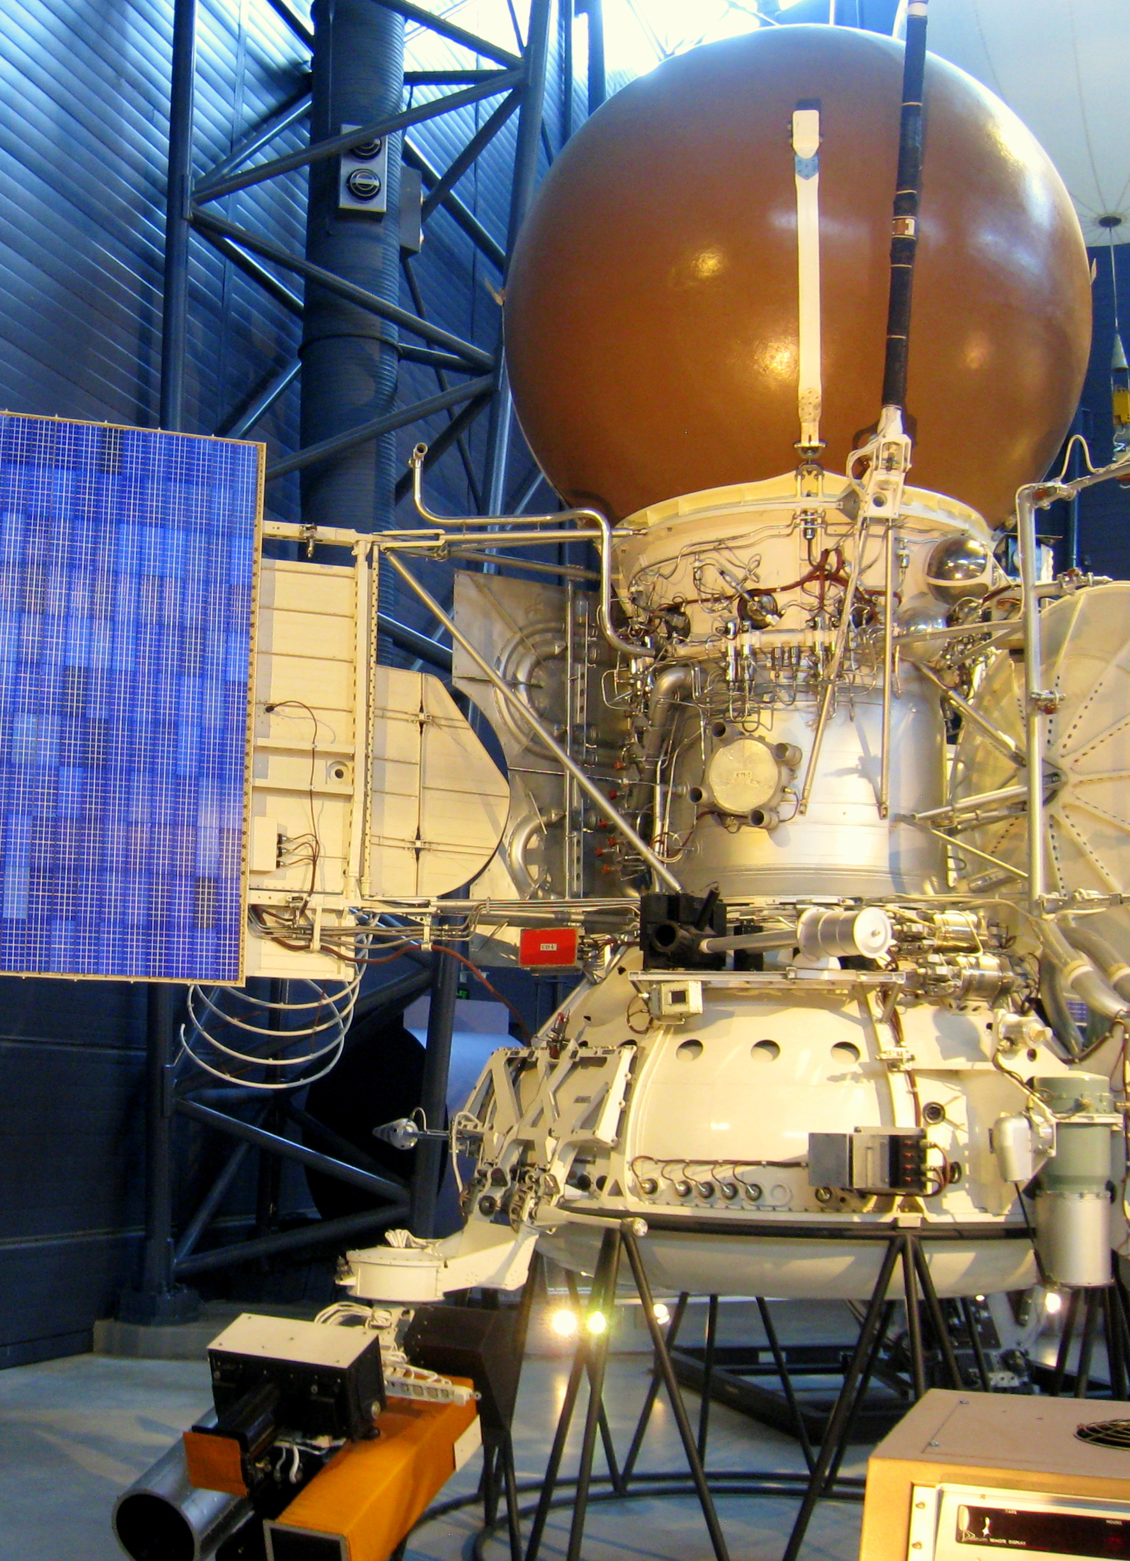
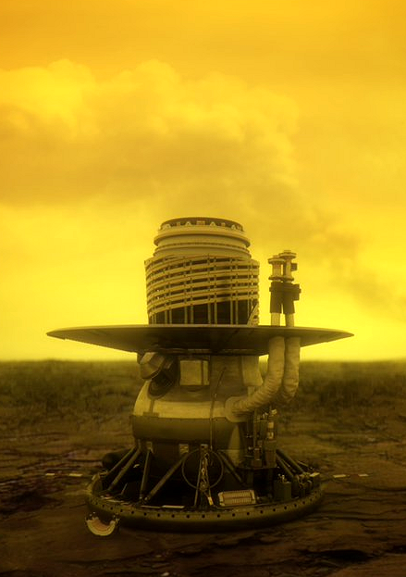
Previous Landers
10 Soviet landers have reached the surface of Venus but they only lasted for about 2 hours due to the failure of batteries and electronics from the high temperature.
The Soviet missions were called Venera and Vega.

Slide 13
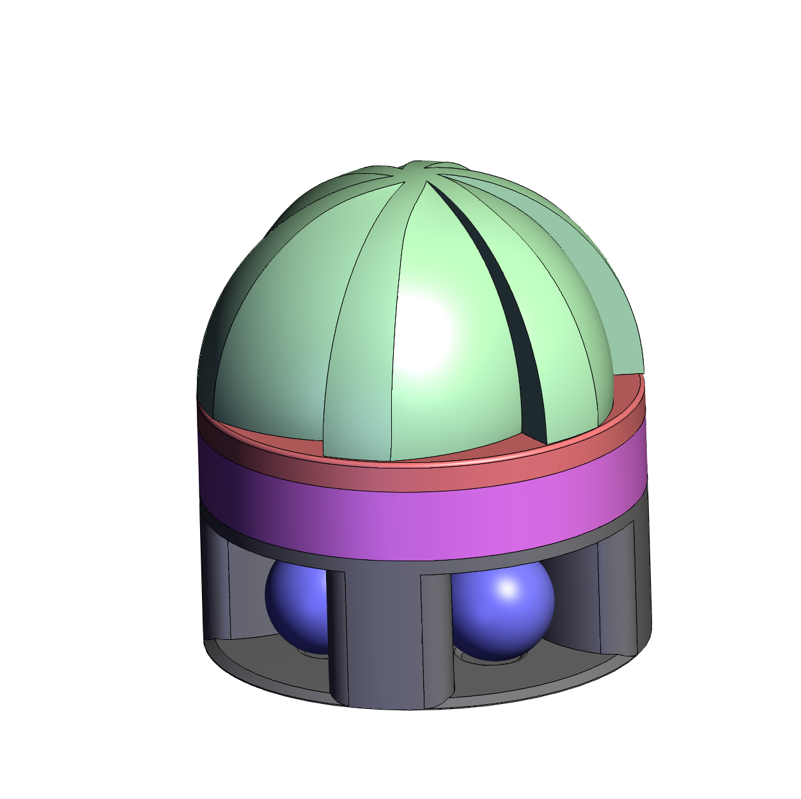
The Lander
It consists of 3 parts:
Wind Turbine:

Slide 14
The Lander
It consists of 3 parts:
Wind Turbine:
Battery:

Slide 15
The Lander
It consists of 3 parts:
Wind Turbine:
Battery:
Charging Station:

Slide 16
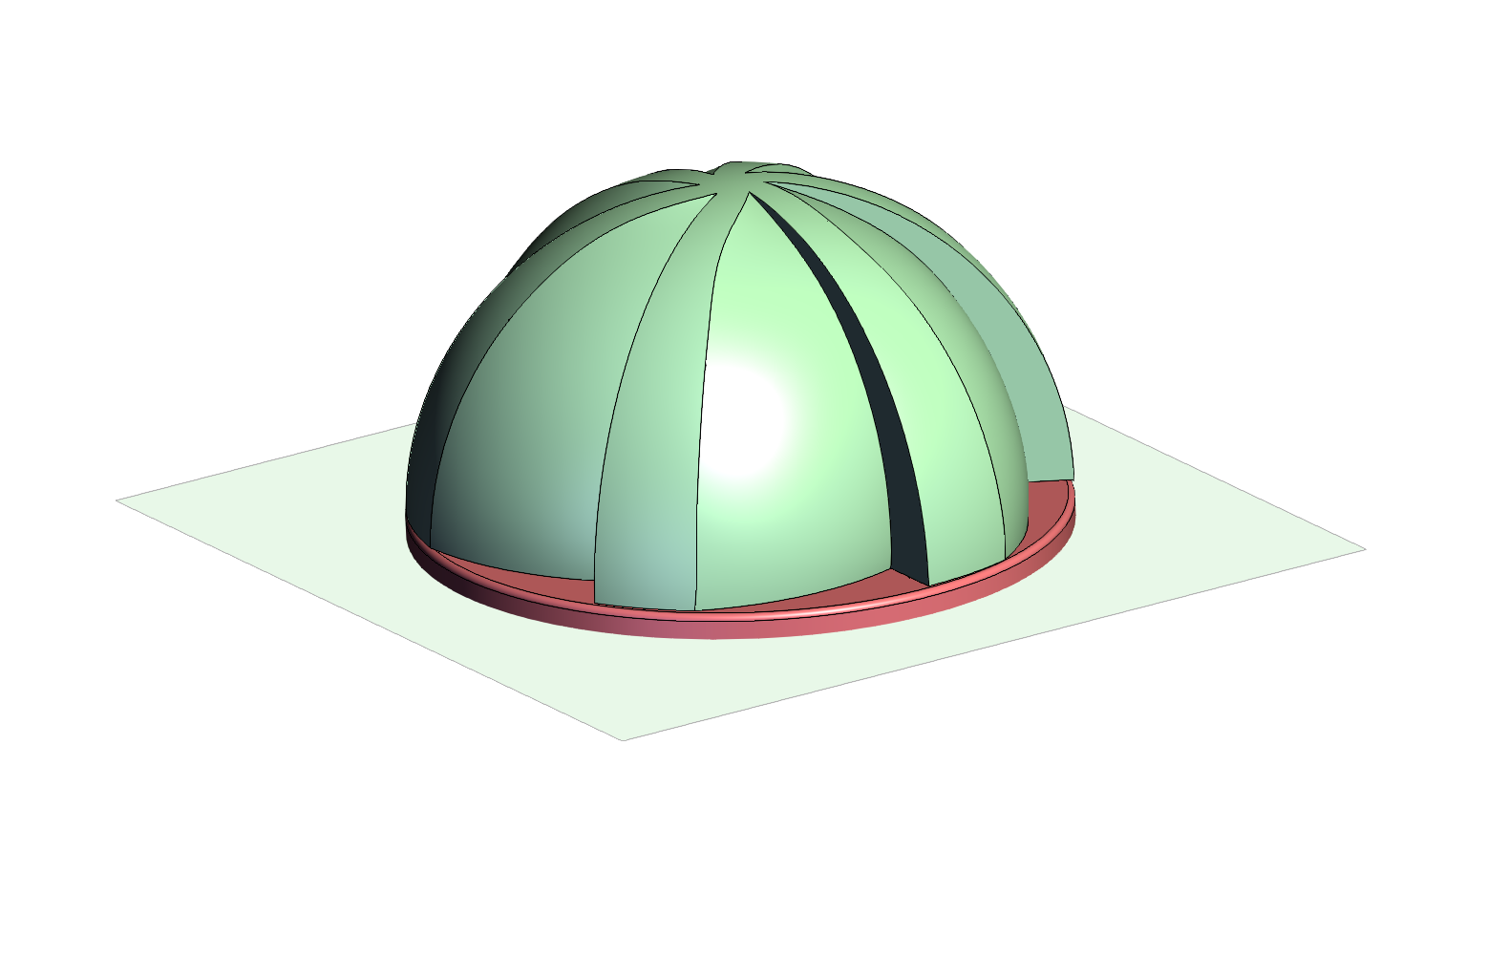
Wind Turbine
We designed an omnidirectional vertical-axis turbine ( VAWT )
Winds at the surface are around 10 km/h
The high density of the atmosphere exerts a significant amount of force which turns the turbine

Slide 17
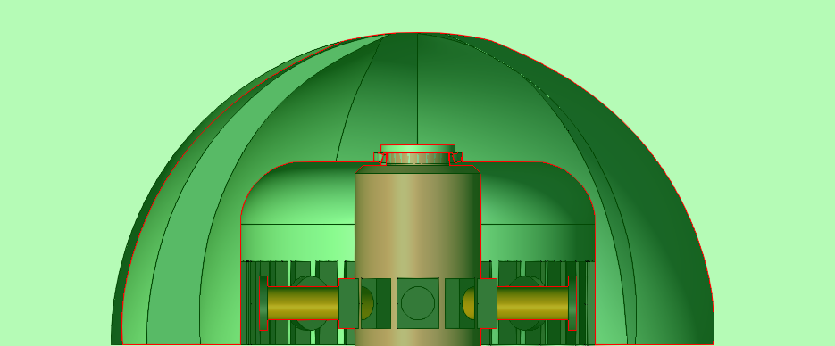
Wind Turbine
Inside it there are permanent magnets that rotate around a static coil when the wind spins the turbine
This generator powers the electromagnets beneath it

Slide 18
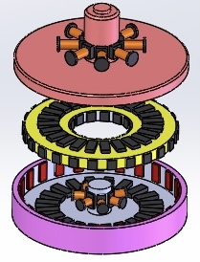
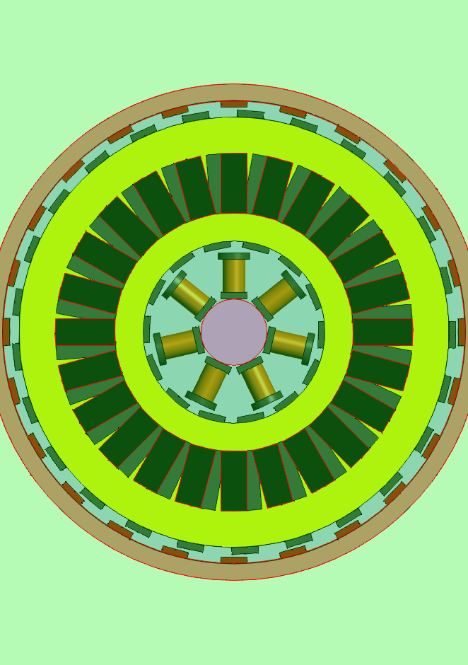
The Battery
The battery is made of a flywheel in vacuum that stores kinetic energy and transforms it into electric current
The flywheel is suspended on a magnetic field for low friction
The magnets placed on the exterior of the wheel keep it stable on the horizontal axis inside the cylinder
The magnets above are used in conjunction with the electromagnets powered by the wind turbine to move the flywheel
The magnets placed on the interior spin around coils creating a generator that powers the charging station

Slide 19
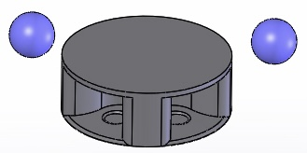
Charging Station
Located on the base of the lander, it is powered by the flywheel via an AC to DC converter.
Can charge up to 4 rovers simultaneously

Slide 20
The Rover
It's a football shaped rover that roams around the base and comes back to recharge its batteries.

Slide 21
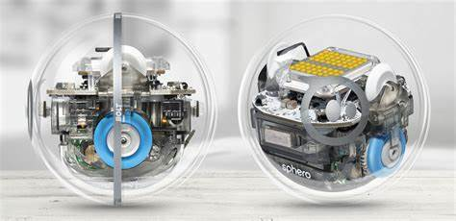
Features:
The robot uses wheels to climb up the outer protective shell walls and pushes them forward, causing the sphere to roll
It uses a chemical battery made of molten salt which can withstand the high temperatures on Venus

Slide 22
Specifications 1/3
Stored energy: Kinetic 37 MJ (10,2 kWh)
Source of energy: Wind
Rotations of flywheel: 9,600 RPM max
Flywheel weight: 256 kg
Self discharge rate: N/A
Volume: 2,85 m3
Mass: 4,100 Kg
Operation temperature range: maximum supported temperature is 600 C
Using the energy released on atmospheric entry and descent: NO

Slide 23
Specifications 2/3
Use of active materials:
Wind Turbine Cupola: Carbon fiber
Wind Turbine Bearing: Steel (Lubricated with Ceramic Grease up to 1,500 °C)
Magnets: Alnico 5-7 (Aluminium, Nickel, Cobalt)
Flywheel: Carbon Fiber
Wiring: Nickel wire
Body of Lander: Titanium Alloy
Coil wire: Nickel clad ceramic insulated copper wire

Slide 24
Specifications 3/3
Whether a protective enclosure is needed: YES
Whether the system can be operated under any orientation: YES
Whether the system uses resources from Venus: YES, the wind
Whether the system can be recharged: YES
Whether the system can tolerate the vibrations due to launch, reentry, descent and landing: YES
Whether the system can tolerate partial failures and still provide energy: YES. Only wind turbine damage is critical.

Slide 25
Team: Navy Seals
Questions?
David: Magnets Research
Andrei: Chief Scientist
Alex: Lander Research and Design
Loredana: Battery Research
Doru: 3D Design
Philip: Project Coordinator

